Slide 1

Mega-Mart Sales Analysis
A Descriptive Report for Mega-Mart Sales

Slide 2

Our Objective
This report is an interactive visual representation of essential business data that allows you to quickly gather vital information about the business performance and make informed decision: Here are key points
Simplification and Clarity
Real-Time Monitoring
Holistic View
Data-Driven Decision-Making

Slide 3
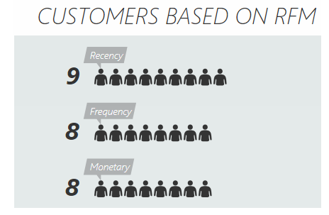
RFM Analysis
The RFM model is a market analysis tool used to identify a company’s best customers by measuring and analyzing purchasing habits or behavior. Here is what each component generally means:
Recency: This segment includes customers who have made purchases more recently. The higher number of icons suggests a larger group of customers in this category, indicating they are likely more engaged, or a higher likelihood of repeat business.
Frequency: This is how often a customer makes a purchase. Frequent purchases suggest a loyal customer.

Slide 4

RFM Analysis
Monetary: This segment represents customers categorized by the monetary value of their purchases. Higher monetary value indicates a customer who generate more revenue for the company. (Big spenders)
By segmenting customers based on these criteria, businesses can tailor their marketing efforts to target different groups effectively, such as offering loyalty programs to frequent buyers or special promotions to those who spend more. It’s a strategic approach to enhance customer retention and increase sales.
With reference to the RFM analysis worksheet, mega-mart analysis recorded over 2,216 customers with 19 customers being most frequent and loyal based on their RFM scores.

Slide 5
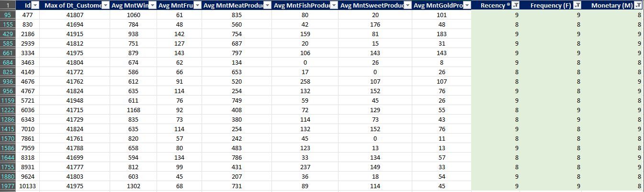
Table showing 19 most valued customers based on their RFM scores
With reference to the RFM_analysis worksheet this table was filtered based on high RFM scores to identify Top customers

Slide 6
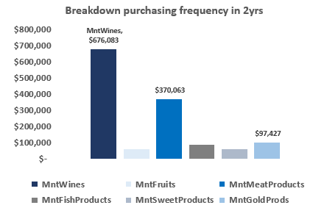
Business Analysis
Breakdown of purchasing frequency over a 2-year period
The chart provides a breakdown of purchasing frequency over a 2-year period for different product categories.
The bars are a visual representation of customers spending habits in different categories, which can be useful for a business to understand where most of their sales are coming from and to strategize marketing efforts accordingly. This is used to analyze customers preferences and spending patterns.
The category MntWines has the highest spending with a total of $676,083 which indicates that wines are the most purchased product among the categories and meats amounting to $370,063 indicating that MntmeatProduct are also popular choice among customers listed over a 2-year period.

Slide 7
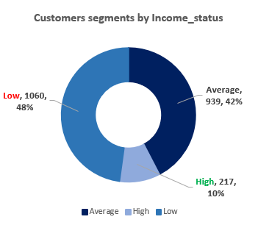
Business Analysis
Customers Segments by Income_Status
This visually represents the distribution of customers within these 3 income categories. This type of segmentation can be very useful for businesses to tailor their marketing strategies and product offerings to different economic/social demographics.
To target high income segments more effectively, businesses can adopt these few strategies;
Offer premium products and services:
Personalization: this segments values personalized experiences. Companies can use data analytics to tailor their marketing messages, offers and products to individual preferences.
Exclusive Experiences: create unique and memorable experiences that cannot be easily replicated. This can include VIP treatment to customers

Slide 8
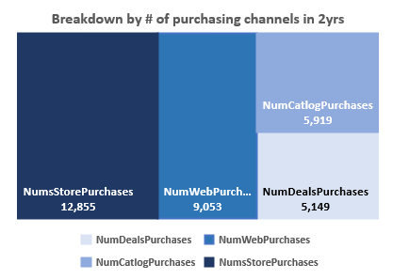
Business Analysis
Breakdown by number of purchasing channels in a 2-year period
This is a breakdown by the number of purchasing channels and it represents where customers are making their purchases, which can help a business understand which sales channels are the most effective and where to focus their sales effort.
To increase NumsStorepurchases which is recorded as the highest purchasing channel, businesses can implement a variety of strategies that enhance the shopping experience and encourage customers to visit and buy from physical stores.

Slide 9

Here are some effective strategies:
Enhance store ambiance: create a welcoming and cozy store environment with good lighting, & music
Focus on Merchandising: Display products attractively and use visual merchandising techniques to draw attention to items.
Optimize store layouts: Design the store layout to facilitate easy navigation.

Slide 10
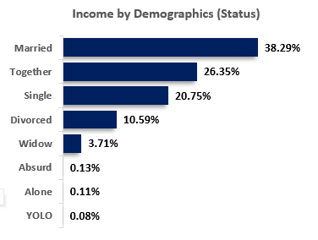
Business Analysis
Income by Demographics (Marital_Status)
This shows the distribution of income across different demographic statuses.
Married: with 38.29% of the income, this group is the largest contributor. It suggests that married individuals might have combined incomes or benefits from dual-income advantage followed by ‘Together’ which also hold significant financial weight.
Insights: Business should consider targeting the Married and Together demographics for products and services, as they represent the majority of income and the lower percentages for widow, absurd, alone, yolo suggest these are less lucrative markets. However, niche marketing strategies could be effective if these groups have specific unmet needs

Slide 11
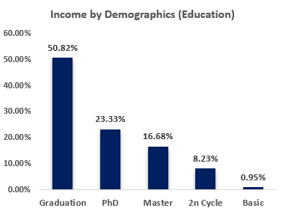
Business Analysis
Breakdown by Demographics (Education)
This illustrates the income distribution among various educational levels.
These bars indicate that individuals with graduation, PhD, and Masters have the highest income share at 50.82%, 23.33%, and 16.68% respectively indicating that advanced degrees are highly valued in the job Market and increases earning potentials.
Employee Investment: Companies might consider investing in their employee’s education, as higher educational qualifications Tends to correlate with higher income levels.
Recruitment Strategy: Also, when recruiting, businesses may want to prioritize candidates with higher education for roles that require complex skills and offer competitive salaries to attract them

Slide 12

Business Insights
By leveraging these insights, Mega-Mart can refine its marketing strategies, optimize profitability, and enhance customer relationships to drive business growth.
Craft personalized campaigns: Use insights from the demographic’s profiles to tailor marketing campaigns. Personalization can significantly increase engagements.
Conduct Targeted Promotions: Run promotions and offers that are likely to appeal to specific segments. For example, “Back-to-school” promotion targeting the ‘Basic’ education level or Luxury item promotions for the “Graduation segment”.
Customers Segmentation: Prioritize marketing efforts on demographics with the highest revenue
Customers Engagement: Maintain the high response rate and address complaints efficiently to enhance customers satisfaction and loyalty
Loyalty programs: Develop loyalty programs or special offers for frequent buyers to encourage repeat purchases and increase customer lifetime value.

Slide 13



Thank You
Oranekwu Ifeanyi
www.DataLab.com.ng

